Slide 1
Module 4: Implement VMs for Windows and Linux
Azure Dedicated Hosts, Scale Sets, Disk Encryption, and High Availability

Slide 2
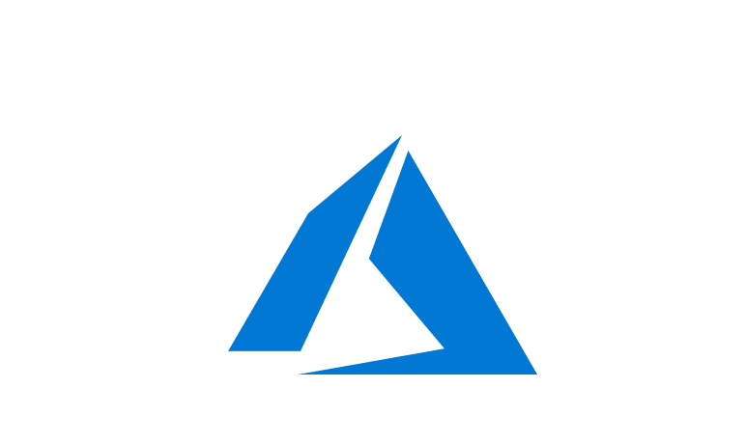
Learning Objectives
You will learn the following:
Running Linux and Windows Virtual Machines on Azure
Select Virtual Machine Size
Configure High Availability
Implement Azure Dedicated Hosts
Deploy and Configure Scale Sets
Configure Azure Disk Encryption

Slide 3
Overview: Running Linux and Windows Virtual Machines on Azure

Slide 4

Checklist for creating an Azure Virtual Machine
Required resources for IaaS Virtual Machines:
Start with the network
Name the VM
Decide the location for the VM
Determine the size of the VM
Understanding the pricing model
Storage for the VM
Select an operating system

Slide 5

Start with the Network
Segregate the network
Create one or more subnets
Secure the network
Create and assign Network Security Groups (NSGs)
Plan each VM deployment

Slide 6
Naming the VM (1 of 2)
Naming convention considerations:
The VM name is configured as part of the operating system.
This name defines a manageable Azure resource—not trivial to change later.
Recommended naming conventions include the following:
Element | Example | Notes
Environment | dev, prod, QA | The environment for the resource
Location | uw (US West), ue (US East) | The Azure region
Instance | 01, 02 | Instance of a resource
Product or service | Service | Product, application, or service that resource supports
Role | sql, web, messaging | Role of the resource

Slide 7
Naming the VM (2 of 2)
A VM deployment includes several resources:
The VM itself
Storage account for the disks
Virtual network (shared with other VMs and services)
Network interface to communicate on the network
Network Security Group(s) to secure network traffic
Public internet address (optional)

Slide 8
Decide the Location of the VM
Azure has datacenters all over the world
Datacenters are grouped into geographic regions
Select a region where you want the resources to be allocated

Slide 9
Determine the Size of the VM (1 of 2)
Azure provides different VM sizes that offer variations of
Processing power
Memory
Storage capacity
Azure provides a wide range of VM size options
General purpose
Compute optimized
Memory optimized
Storage optimized
GPU
High performance compute
Confidential computing

Slide 10
Determine the Size of the VM (2 of 2)
Option | Description
General purpose | Balanced CPU-to-memory ratio. Ideal for testing and development, small to medium databases, and low to medium traffic web servers.
Compute optimized | High CPU-to-memory ratio. Suitable for medium traffic web servers, network appliances, batch processes, and application servers.
Memory optimized | High memory-to-CPU ratio. Great for relational database servers, medium to large caches, and in-memory analytics.
Storage optimized | High disk throughput and IO. Ideal for VMs running databases.
GPU | Heavy graphics rendering and video editing. These VMs are ideal options for model training and inferencing with deep learning.
High performance compute | The fastest and most powerful CPU with optional high-throughput network interfaces.
Confidential compute | Designed to protect the confidentiality and the integrity of data and code while it's processed in the cloud.

Slide 11
Virtual Machine Sizes (Windows and Linux)
Type | Sizes | Description
General purpose | B, Dsv3, Dv3, Dasv4, Dav4, DSv2, Dv2, Av2, DC, DCv2, Dv4, Dsv4, Ddv4, Ddsv4 | Balanced CPU-to-memory ratio. Ideal for testing and development, small to medium databases, and low to medium traffic web servers.
Compute optimized | Fsv2 | High CPU-to-memory ratio. Good for medium traffic web servers, network appliances, batch processes, and application servers.
Memory optimized | Esv3, Ev3, Easv4, Eav4, Ev4, Esv4, Edv4, Edsv4, Mv2, M, DSv2, Dv2 | High memory-to-CPU ratio. Great for relational database servers, medium to large caches, and in-memory analytics.
Storage optimized | Lsv2 | High disk throughput and IO ideal for Big Data, SQL, NoSQL databases, data warehousing and large transactional databases.
GPU | NC, NCv2, NCv3, ND, NDv2 (Preview), NV, NVv3, NVv4 | Specialized virtual machines targeted for heavy graphic rendering and video editing, as well as model training and inferencing (ND) with deep learning. Available with single or multiple GPUs.
High performance compute | HB, HBv2, HC, H | Our fastest and most powerful CPU virtual machines with optional high-throughput network interfaces (RDMA).
Confidential compute | DCsv2-Series | Supports a larger range of deployment capabilities, have 2x the Enclave Page Cache (EPC) and a larger selection of sizes compared to the DC-Series VMs.
Virtual Machine by series: https://azure.microsoft.com/en-us/pricing/details/virtual-machines/series/

Slide 12
The Pricing Model
There are two separate costs charged for every VM
Compute costs
Storage costs
There are two main payment options for compute costs
Pay as you go
Reserved Virtual Machine instances

Slide 13
Select an Operating System
Azure provides a variety of OS images you can install into the VM, including:
All currently supported versions of Windows
All major Linux distributions
You can search Azure Marketplace for more install images
You can create your own custom images to create Azure VMs

Slide 14



Storage for the VM
Each Azure VM has two or more disks:
OS disk
Temporary disk
Data disks (optional)
OS and data disks reside in Azure Storage accounts:
Azure-based storage service
Standard (HDD, SSD) or Premium (SSD), or Ultra (SSD)
When creating an Azure VM, you can choose between:
Managed disks (recommended)
Unmanaged disks
Azure VM (Windows)
C:\
Operating system disk
F:\
Data disk
D:\
Temporary disk
(contents can be lost)
Azure blob

Slide 15
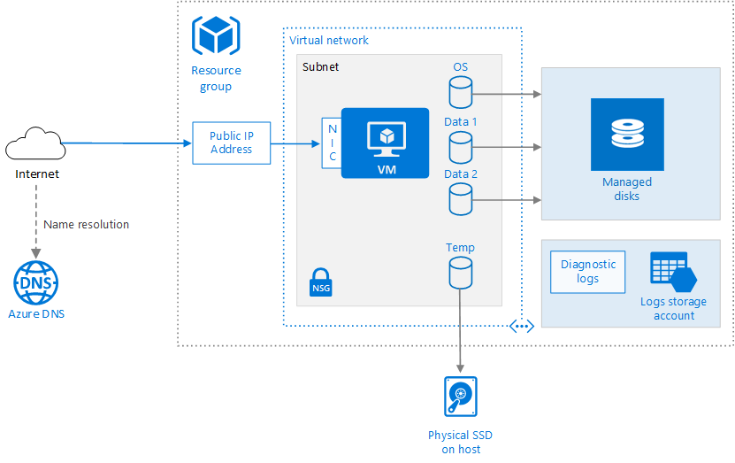
Running Linux and Windows Virtual Machines on Azure
Azure VM deployments includes other resources
Networking
Storage
Place related resources in the same resource group to simplify
Management
Cost tracking
deprovisioning

Slide 16
Configure High Availability

Slide 17
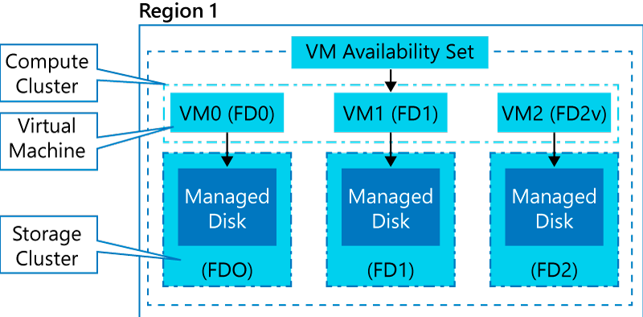
Availability Sets (1 of 2)
An availability set is a logical grouping of VMs within a datacenter:
Automatically distributes VMs across fault and update domains on compute clusters
With managed disks, it provides equivalent resiliency on storage clusters
Provides 99.95% availability SLA (for 2 or more VMs)

Slide 18
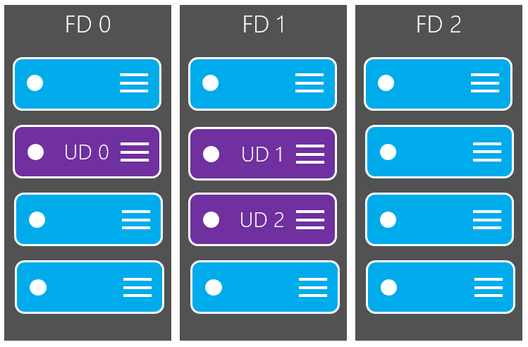
Availability Sets (2 of 2)

Slide 19
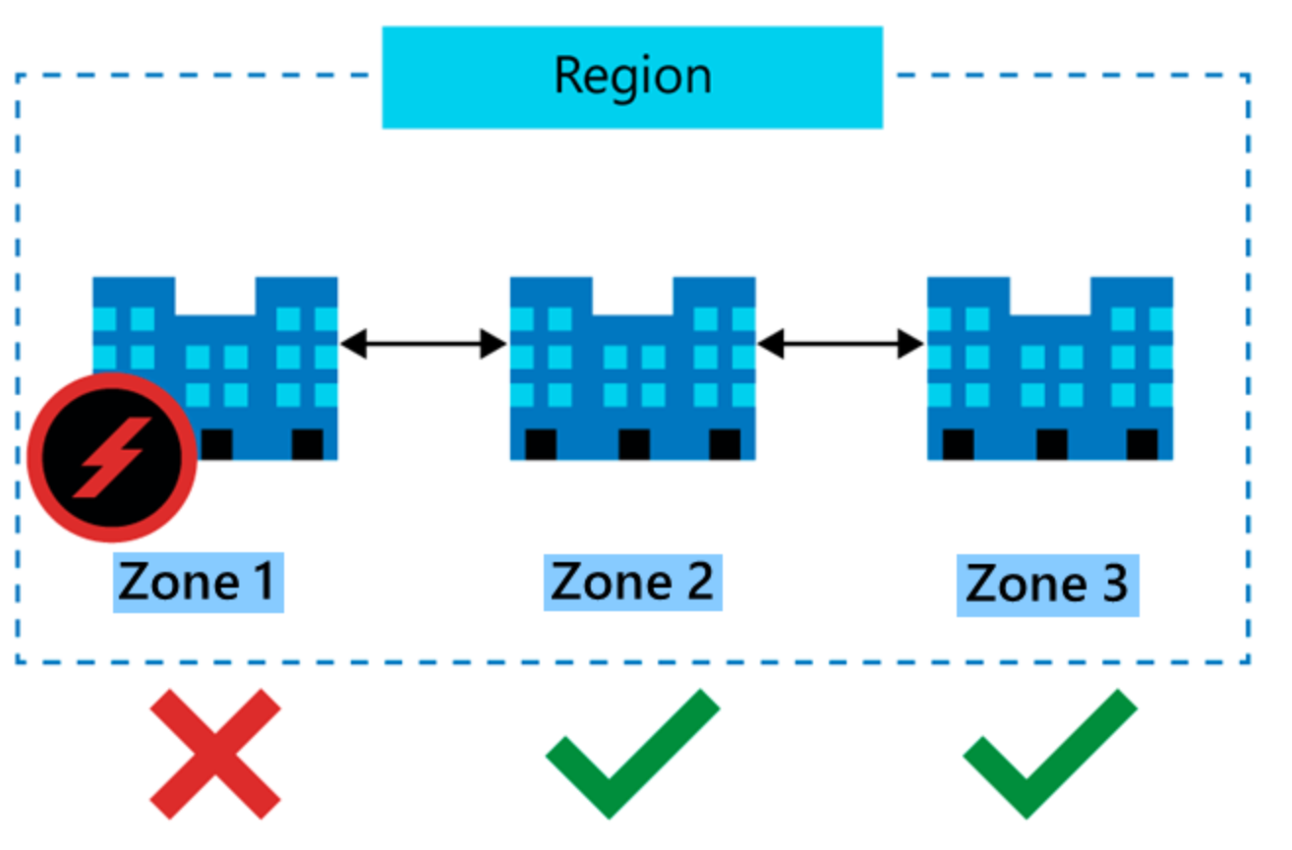
Availability Zones
Core concepts:
Availability zones
Fault domains
Update domains

Slide 20
Virtual Machine Scale Sets
Consist of identically configured, load balanced VMs
Support manual, scheduled and automatic scaling
Automatically distributes VMs across fault domains and update domains

Slide 21
Deploy and Configure Scale Sets

Slide 22
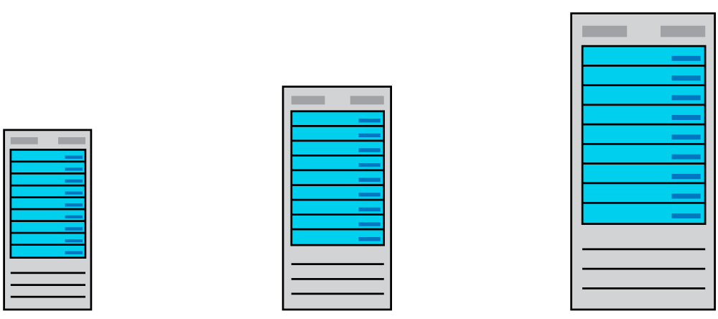
Scaling Concepts (1 of 2)
Vertical scaling

Slide 23
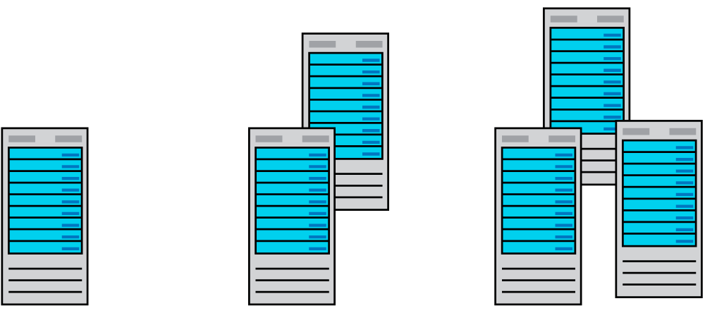
Scaling Concepts (2 of 2)
Horizontal scaling

Slide 24
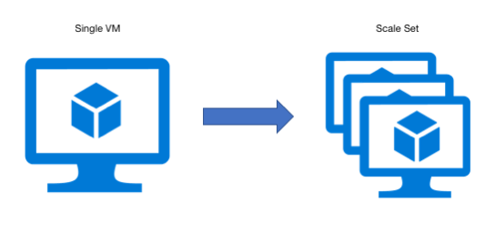
Scale Sets
Scale set benefits
Simplicity: All VM instances are created using the same based OS
Load balancer support: layer 4 and layer 7
High availability: multiple instances of the same workload
Autoscaling: the number of instances adjusts dynamically based on demand
Scalability: up to 1,000 VM instances (600 when using custom images)

Slide 25
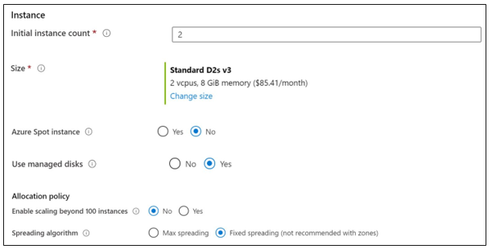
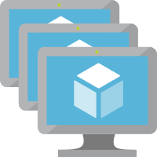
Implementing Scale Sets
Initial instance count
Instance size
Azure spot instance
Use managed disks
Enable scaling beyond 100 instances
Spreading algorithm

Slide 26
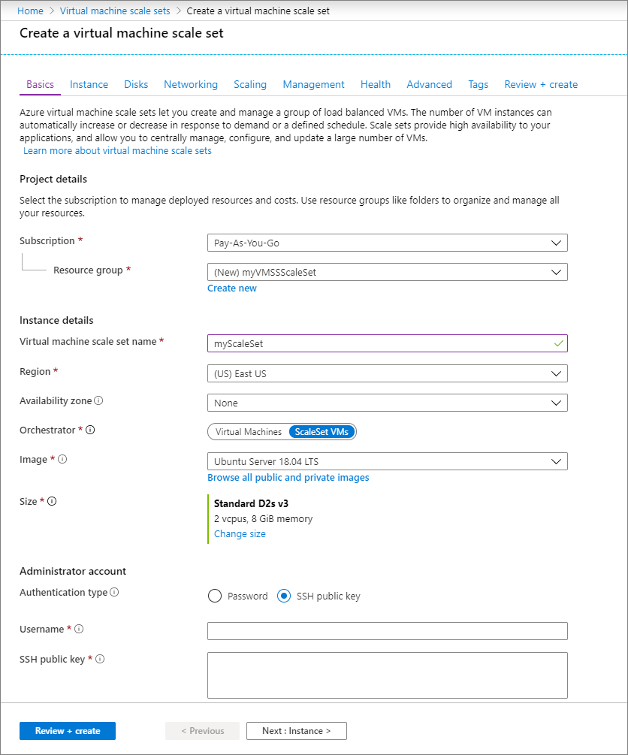
Create a VM Scale Set in the Azure Portal
Create a public load balancer
Create virtual machine scale set

Slide 27
Implement Azure VM Dedicated Hosts

Slide 28
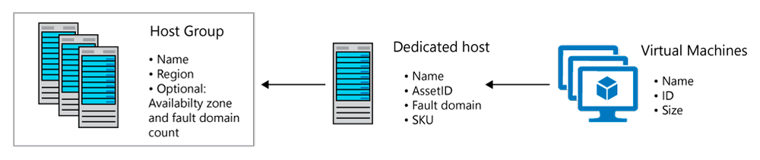
Azure Dedicated Hosts
Benefits:
Implement hardware isolation at the physical server level
Control impact of maintenance events initiated by the Azure platform

Slide 29

High Availability Considerations
Use Availability Zones for fault isolation
Create one host group per zone
Use Fault Domains for fault isolation
Assign a fault domain for each host in the same host group
Use Availability Zones and Fault Domains
Create one host group per zone
Assign a fault domain for each host in the same host group

Slide 30
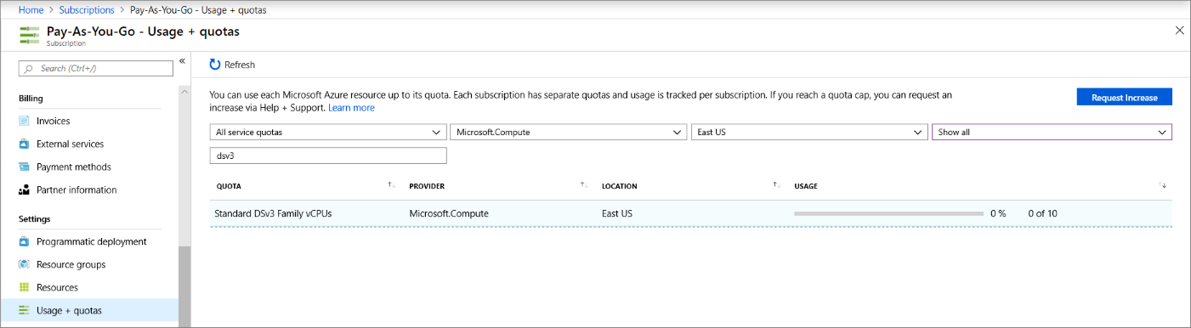
Azure Dedicated Hosts Capacity
Quotas
Limit vCPUs for dedicated hosts per region
Support quota increase
Pricing
Per dedicated host (regardless of the number of deployed VMs)
Based on VM family, type, and region

Slide 31
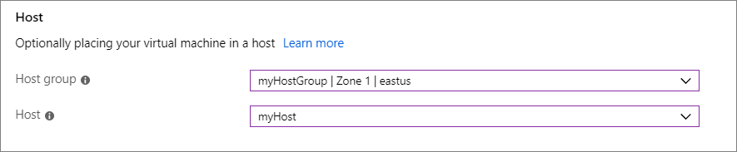
Deploy VMs to Dedicated Hosts
Limitations:
Virtual machine scale sets are supported on dedicated hosts
The sizes and hardware types available for dedicated hosts vary by region
To deploy highly available VMs to dedicated hosts:
Create one or more host groups
Create one or more hosts in each group
Create a VM on each host

Slide 32
Configure Azure Disk Encryption

Slide 33
Azure Encryption Technologies
Two main encryption-based disk protection methods Azure VMs
Storage Service Encryption (SSE)
Azure Disk Encryption (ADE)
Storage Service Encryption (SSE)
enabled for all new and existing storage accounts
cannot be disabled
Azure Disk Encryption (ADE)
managed by the VM owner
uses BitLocker on Windows VMs and DM-Crypt on Linux VMs
stores encryption keys in Azure Key Vault

Slide 34
Deciding When to use Encryption
Disk encryption methods are complementary
Storage Service Encryption (SSE) is part of Azure (mandatory)
Azure Disk Encryption (ADE) makes use of OS tools (optional)
Using both provides a defense-in-depth protection

Slide 35
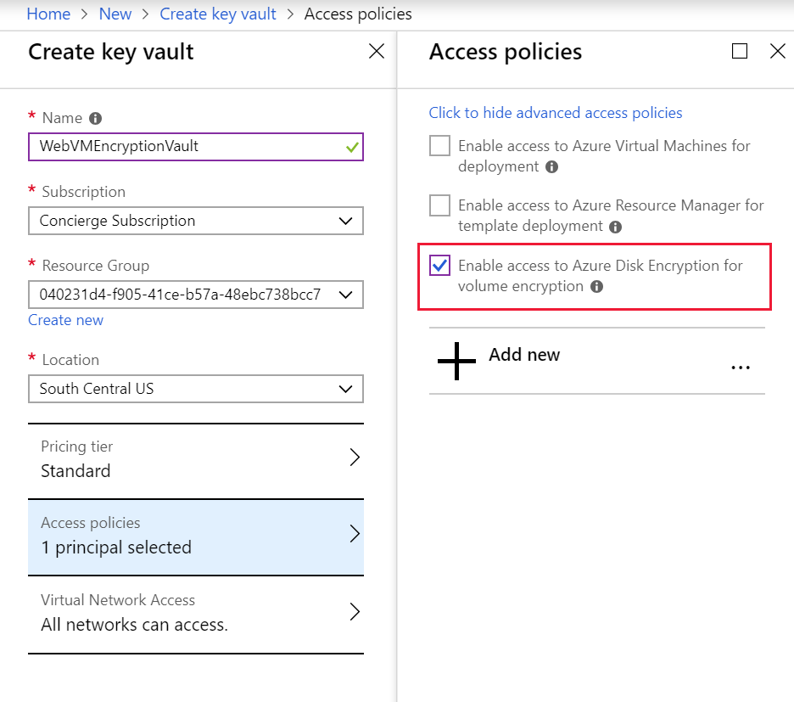
Encrypt an Existing VM Disk
Azure Disk Encryption prerequisites:
An Azure key vault
A key vault access policy that enables support for disk encryption
ADE encryption keys stored in the key vault
To encrypt an existing VM disk, use:
Azure PowerShell
Azure CLI

Slide 36

Module Review Questions

